Slide 1
Prisma Cloud Introduction
May 24, 2022

Slide 2

Contents
1
Prisma Cloud – Business Case
2
Prisma Policies
3
Prisma Standards
4
Prisma API & Terraform Provider
5
Alerting and Sentinel Integration
6
Q&A
7
Reference Links
8
Appendix

Slide 3

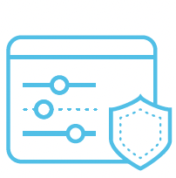


Prisma Cloud
Prisma Cloud is a Cloud Native Security Platform.
Prisma has a broad security and compliance coverage—for applications, data, and the entire cloud native technology stack—throughout the development lifecycle
Prisma is platform Agnostic.
Cloud Security Posture Management
The CSPM capabilities include the Visibility, Compliance, & Governance, Threat Detection, and Data Security features on Prisma Cloud
Cloud Workload Protection
For securing your host, container, and functions across the application lifecycle that constitute the CWP capabilities
Identity-Based Microsegmentation
Enforce permissions and secure identities across workloads and clouds
IAM Security & Code Security
Gain network viibility, enforce microsegmentation, and secure trust boundries.
Integrate and perform infrastructure and application security in the CI/CD pipeline
Pillars of Prisma Cloud

Slide 4
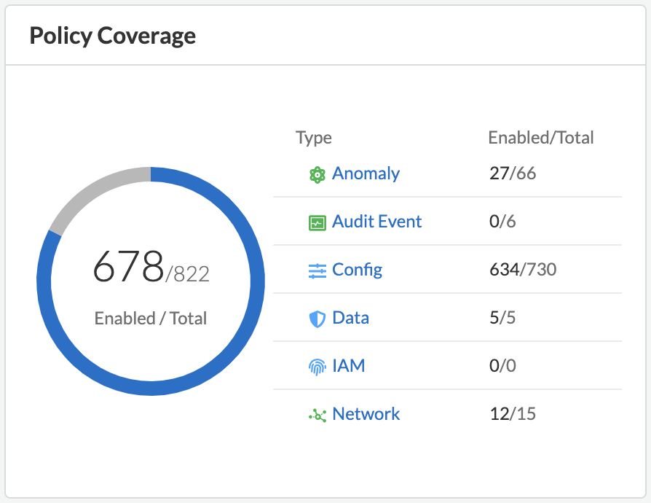
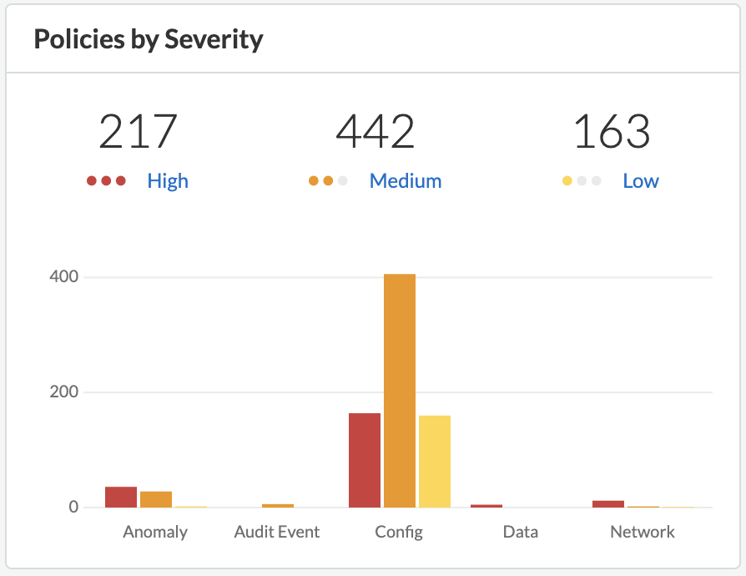
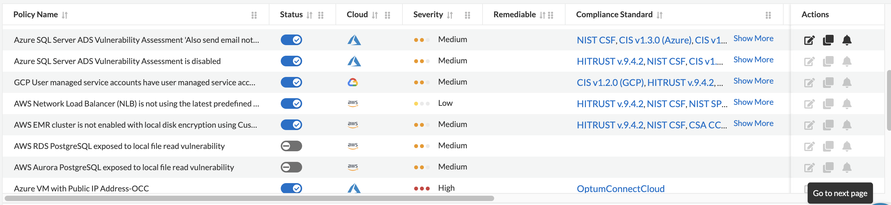
Prisma Policies
In Prisma Cloud, a policy is a set of one or more constraints or conditions that must be adhered to.
Prisma Cloud provides predefined policies for configurations and access controls that adhere to established security best practices such as PCI, GDPR, ISO 27001:2013,and NIST.
In addition to these predefined policies, we can create custom policies to monitor for violations and enforce our own organizational standards.
After setting up the policies, any new or existing resources that violate these policies are automatically detected.

Slide 5
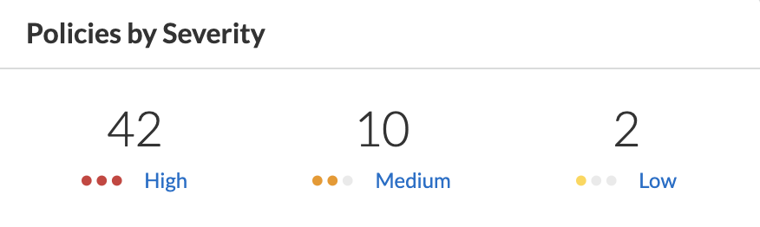
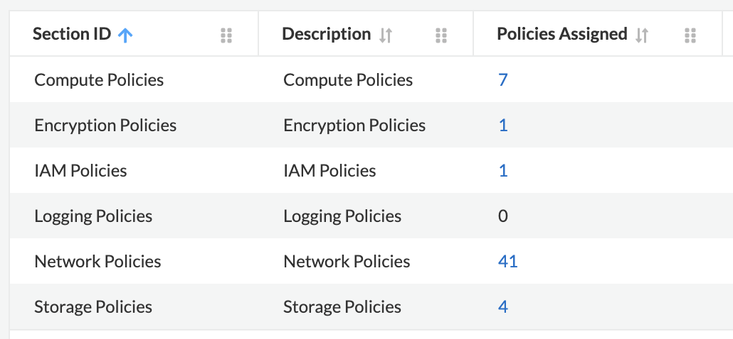
Prisma Standards
Prisma Cloud has 57 Compliance Standards
These include HIPAA, GDPR, ISO, NIST and many more
OCC has its own custom standard created in Prisma called ‘OptumConnectCloud’
These policies are mirrored with the HCC LaunchPad policies

Slide 6
Prisma API & Terraform Provider

Slide 7
Alerting and Sentinel Integration

Slide 8
Q&A
5 minutes

Slide 9
Reference Links
https://www.paloaltonetworks.com/prisma/cloud
https://docs.paloaltonetworks.com/prisma/prisma-cloud
https://docs.paloaltonetworks.com/prisma/prisma-cloud/prisma-cloud-admin
https://docs.paloaltonetworks.com/prisma/prisma-cloud/prisma-cloud-rql-reference/rql-reference
https://docs.paloaltonetworks.com/prisma/prisma-cloud/prisma-cloud-release-notes/prisma-cloud-release-information
https://prisma.pan.dev/api/cloud/

